Slide 1
Categorical Variable in
Graphical model

Slide 2
Data : CAL 500
502 songs with their 242 features:
- 174 binary features labeled by experts
- Emotion
- Genre
- Instrument
- Song characteristics
- Usage
- Vocal
- 68 numeric features
-Based on the short time Fourier transform and some other techniques

Slide 3
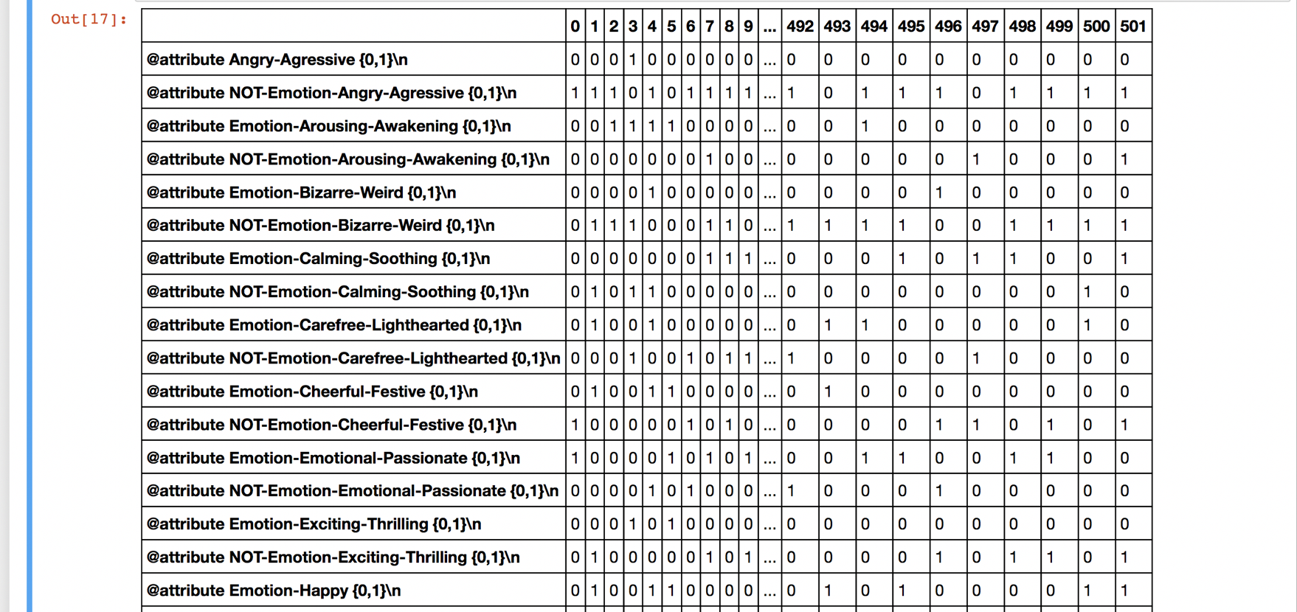
Part of data sample: Binary data

Slide 4
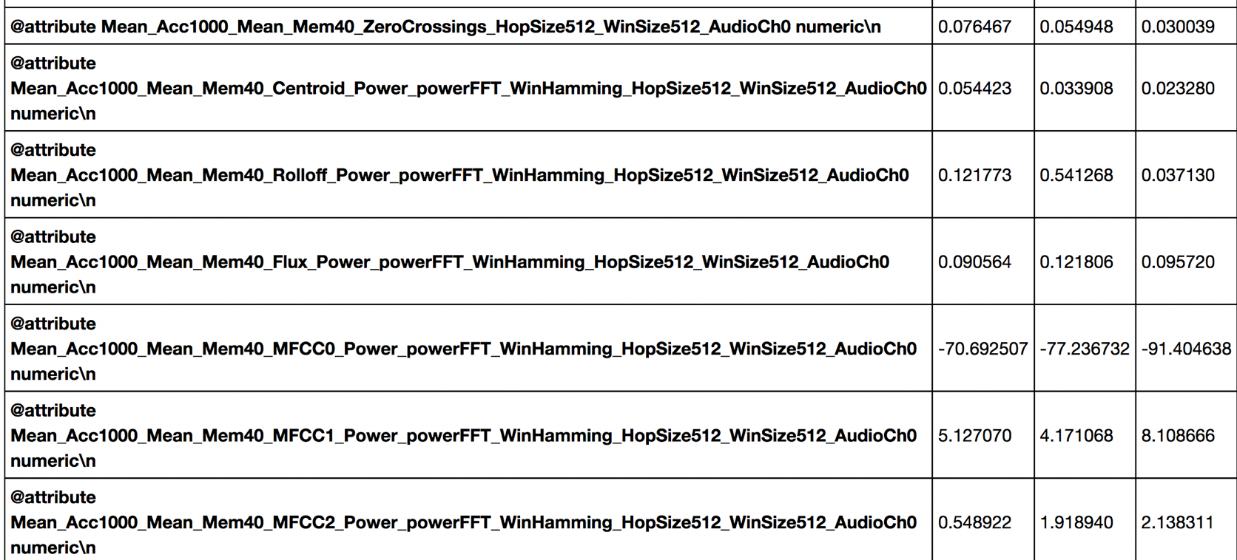
Aim: Structure Estimation
Understand how these different types of variables are associated with each others.
Find conditional independence(?)
Represent those variable by a graphical model
Data come from a joint distribution which have graphical structure

Slide 5
Aim: Structure Estimation
Understand how these different types of variables are associated with each others.
Find conditional independence
Represent those variable by a graphical model
Data come from a joint distribution which have graphical structure
Recover graphical structure from data

Slide 6
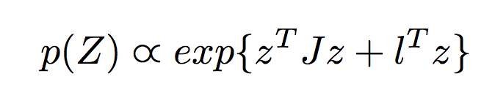
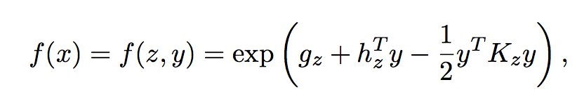
Previous Work
Undirected model
X = (Y, Z)
Y numeric nodes
Z binary
Y : Gaussian Model
Z : Ising Model
Joint distribution:

Slide 7
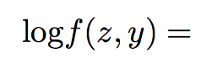
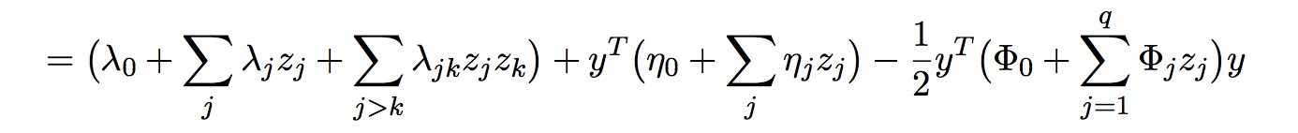
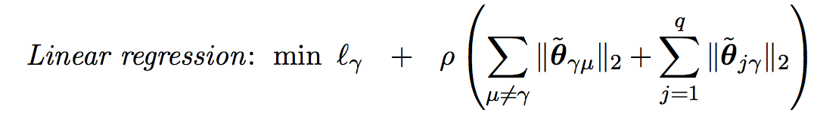
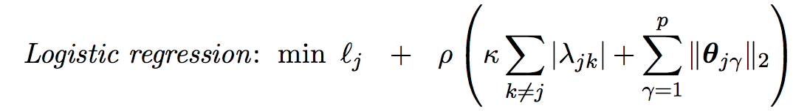
Previous Work
For Gaussian variable :
For Binary variable:

Slide 8
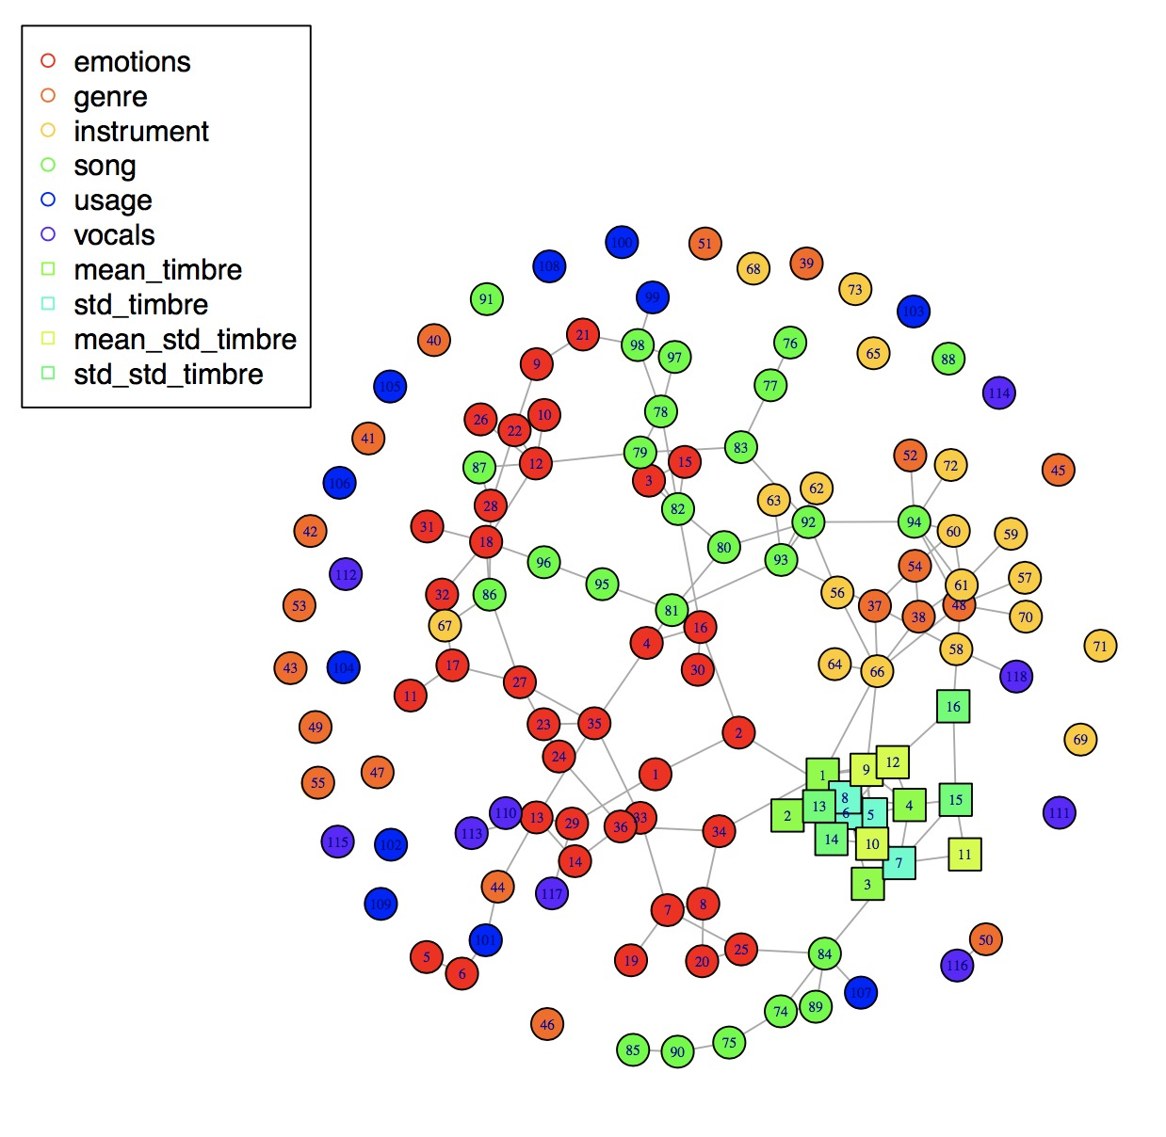
Graphical Model

Slide 9
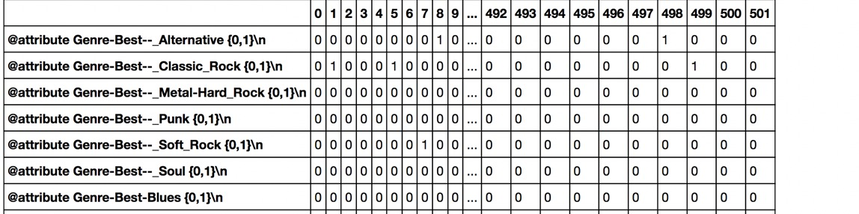
Observation : Categorical variables
Some groups of binary data may come from split categorical data.
-Emotion
-Genre

Slide 10
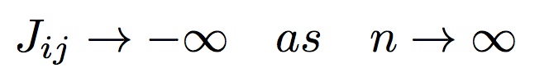
Problem: Ising model for categorical variable
Inconsistency: unbalance of different level of category
for categories with few levels: dense
fast
for categories with many levels: sparse
Even through
Very slow
Under same penalty
structure in categories with many levels disappear

Slide 11
Some genre variables are isolated

Slide 12
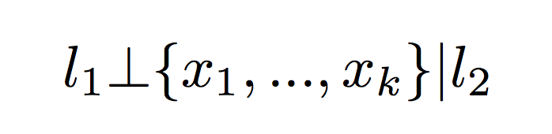
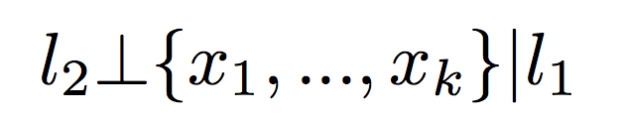
Problem: Conditional independence
Suppose data is composed of split categorical variable l1, l2, and binary variable z1, z2, … ,zk
Conditional independence:
l1, l2 are isolated from other variable
Using Conditional independence directly not appropriate

Slide 13
Graphical model with categorical structure
categorical structure unknown
categorical variable detection
Dataset(?)
categorical structure known
Ising model (not proper)
Logistic regression
Multinomial logistic regression

Slide 14
Present challenges
Proposes
Binary versus Binary
Category versus Binary
Category versus Category
Data generation
Joint distribution (?)
Category versus Category

Slide 15
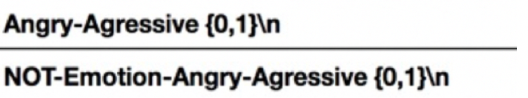
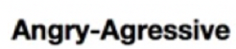
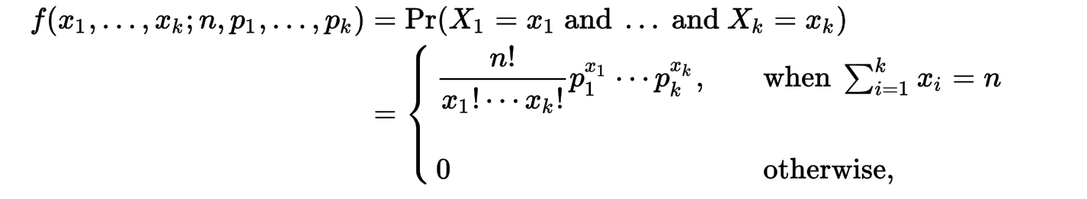
Categorical Variable Detection
Categorical data may follow multinomial distribution with n = 1.

Slide 16
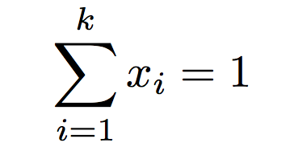
Characteristics of Multinomial distribution
Exclusion property when n = 1
Dot product of two feature data in the same category must be 0

Slide 17
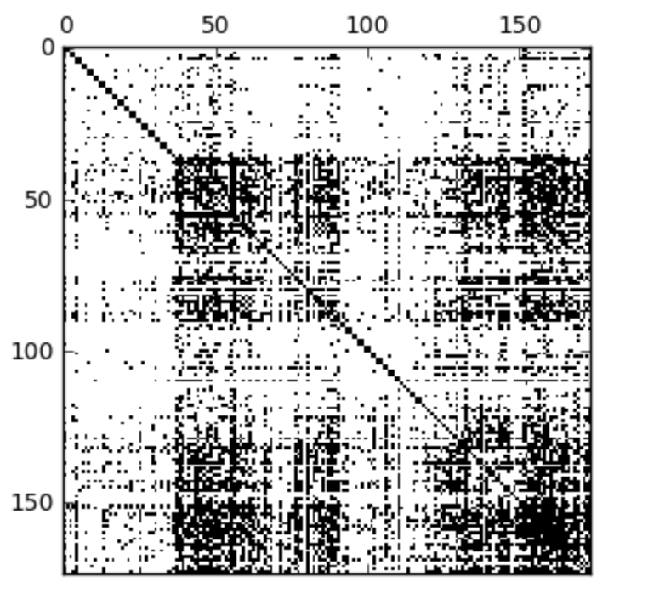
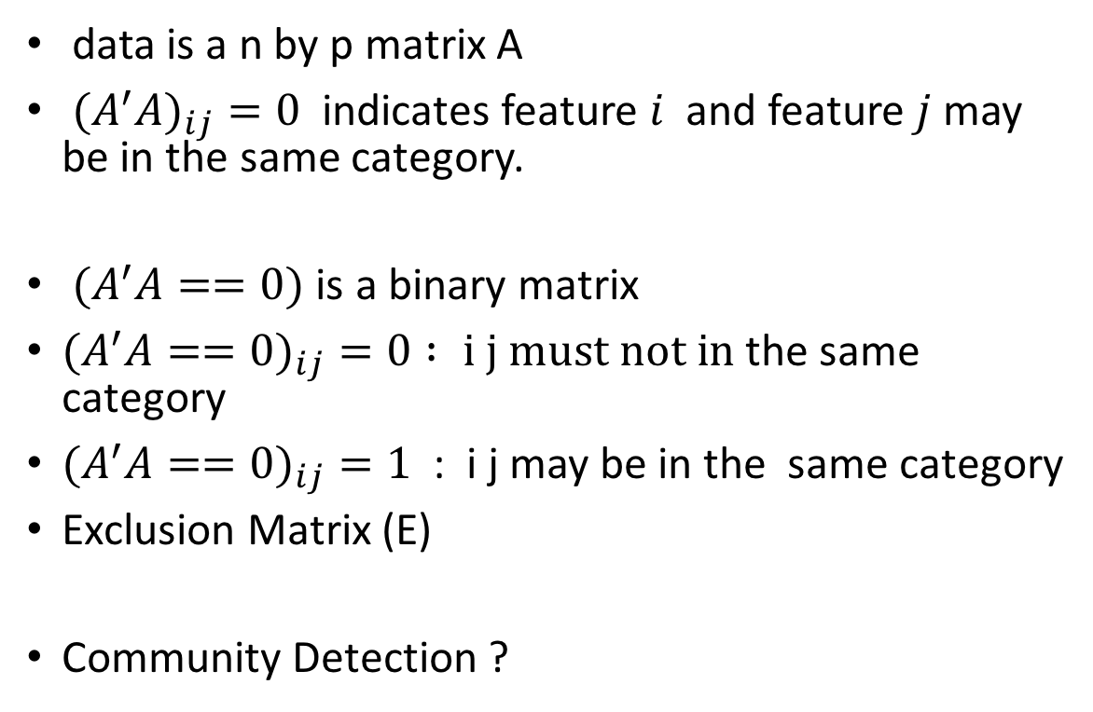
Exclusion Matrix
data is a n by p matrix A
${(A}^{′}{A)}_{ij}=0$ indicates feature $i$ and feature $j$ may be in the same category.
$(A^{′}A==0)$ is a binary matrix
$(A^{′}A==0)_{ij}=0 : i j must not in$the same category
$(A^{′}A==0)_{ij}=1$ : i j may be in the same category
Exclusion Matrix (E)
Community Detection ?
Exclusion Matrix of cal500

Slide 18
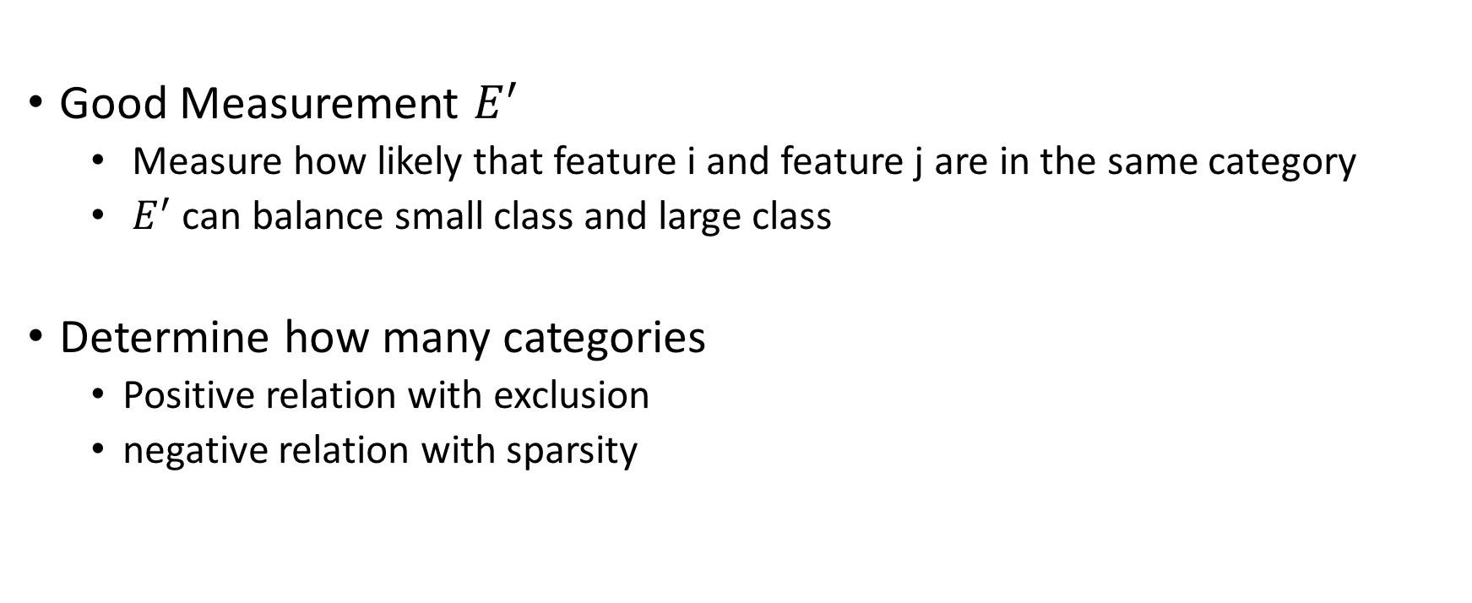
Main Purposes
Good Measurement $E^{′}$
Measure how likely that feature i and feature j are in the same category
$E^{′}$ can balance small class and large class
Determine how many categories
Positive relation with exclusion
negative relation with sparsity

Slide 19
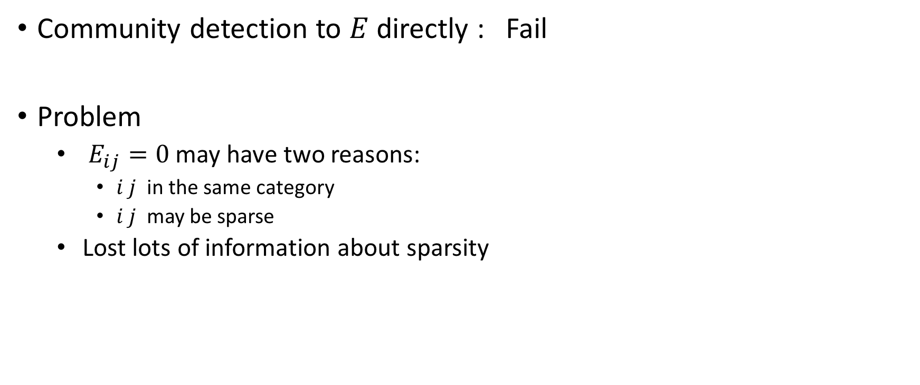
Community Detection
Community detection to $E$directly : Fail
Problem
$E_{ij}=0$may have two reasons:
$i j$ in the same category
$i j$ may be sparse
Lost lots of information about sparsity

Slide 20
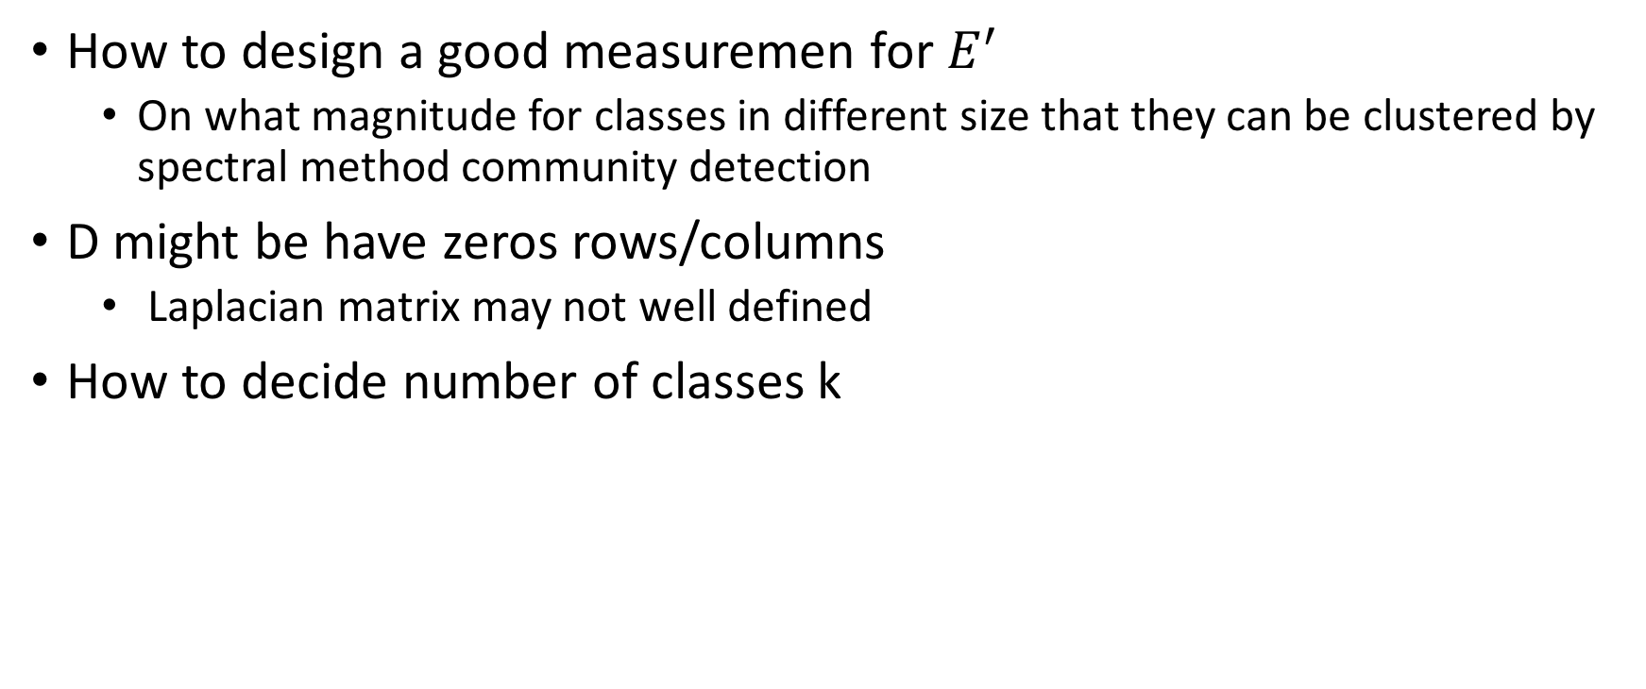
Some problems
How to design a good measuremen for $E^{′}$
On what magnitude for classes in different size that they can be clustered by spectral method community detection
D might be have zeros rows/columns
Laplacian matrix may not well defined
How to decide number of classes k

Slide 21
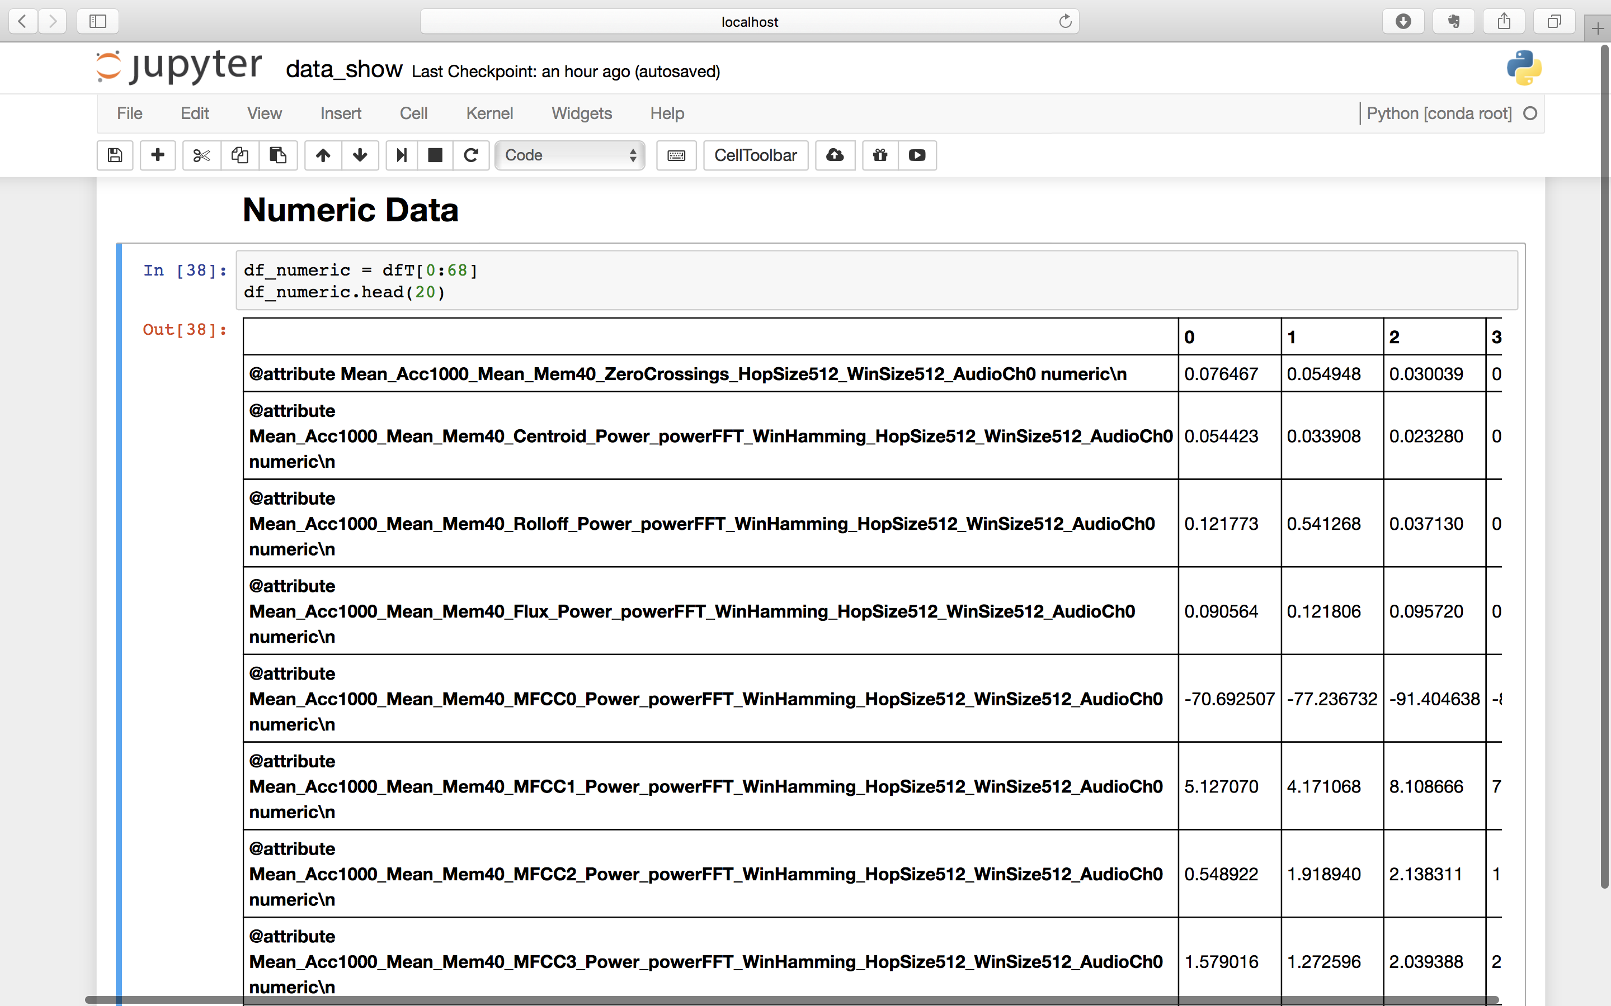

Slide 22
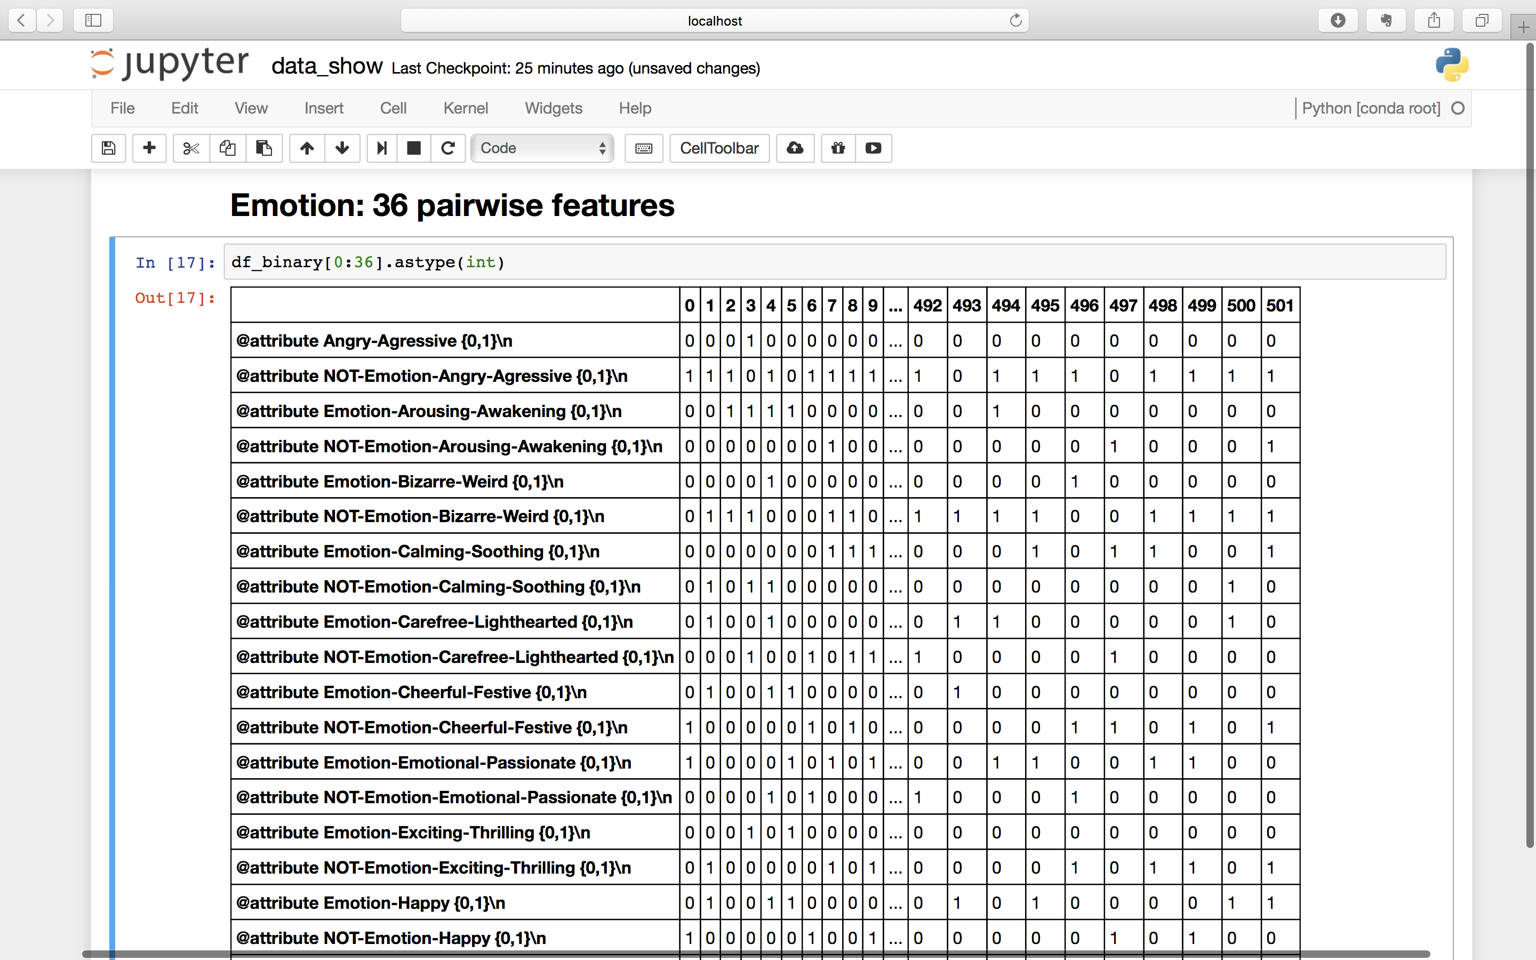

Slide 23
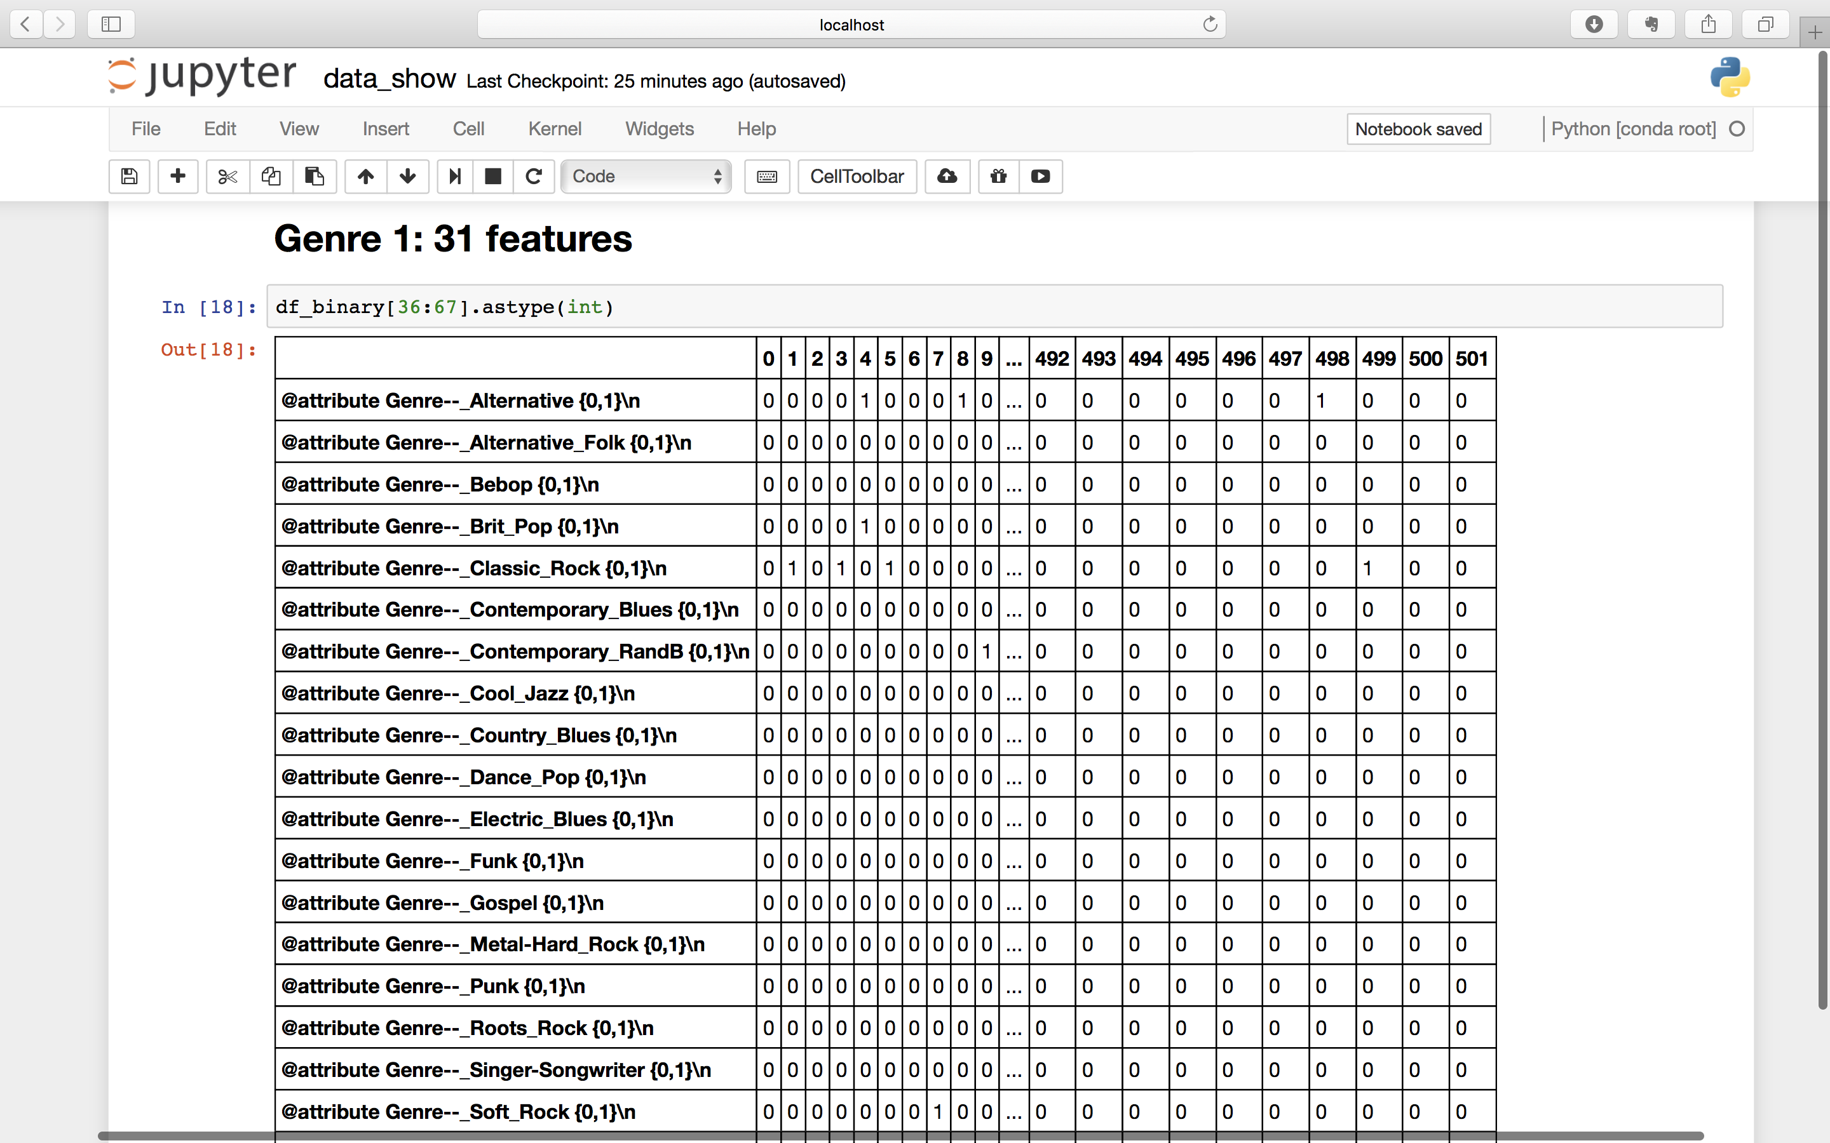

Slide 24
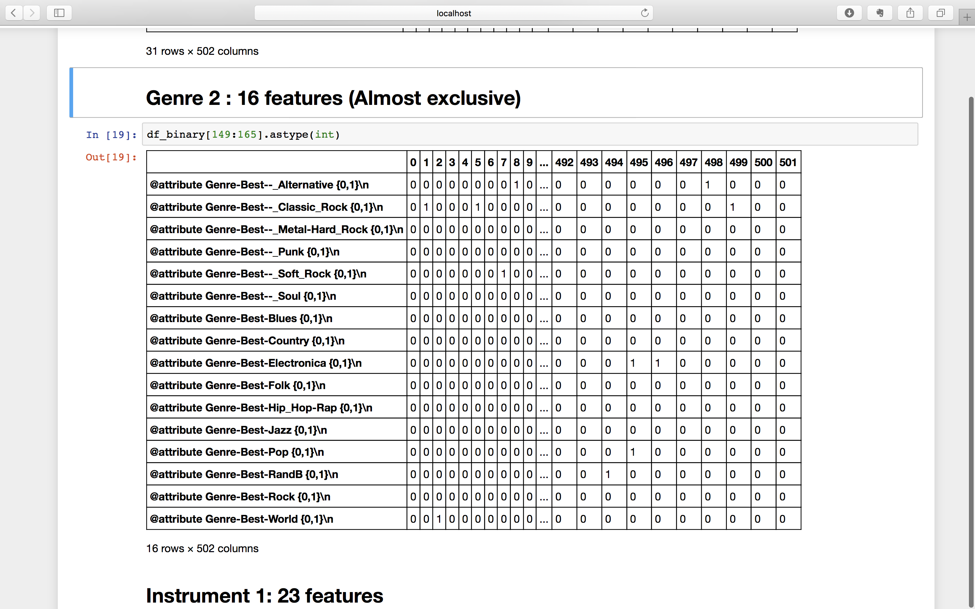

Slide 25
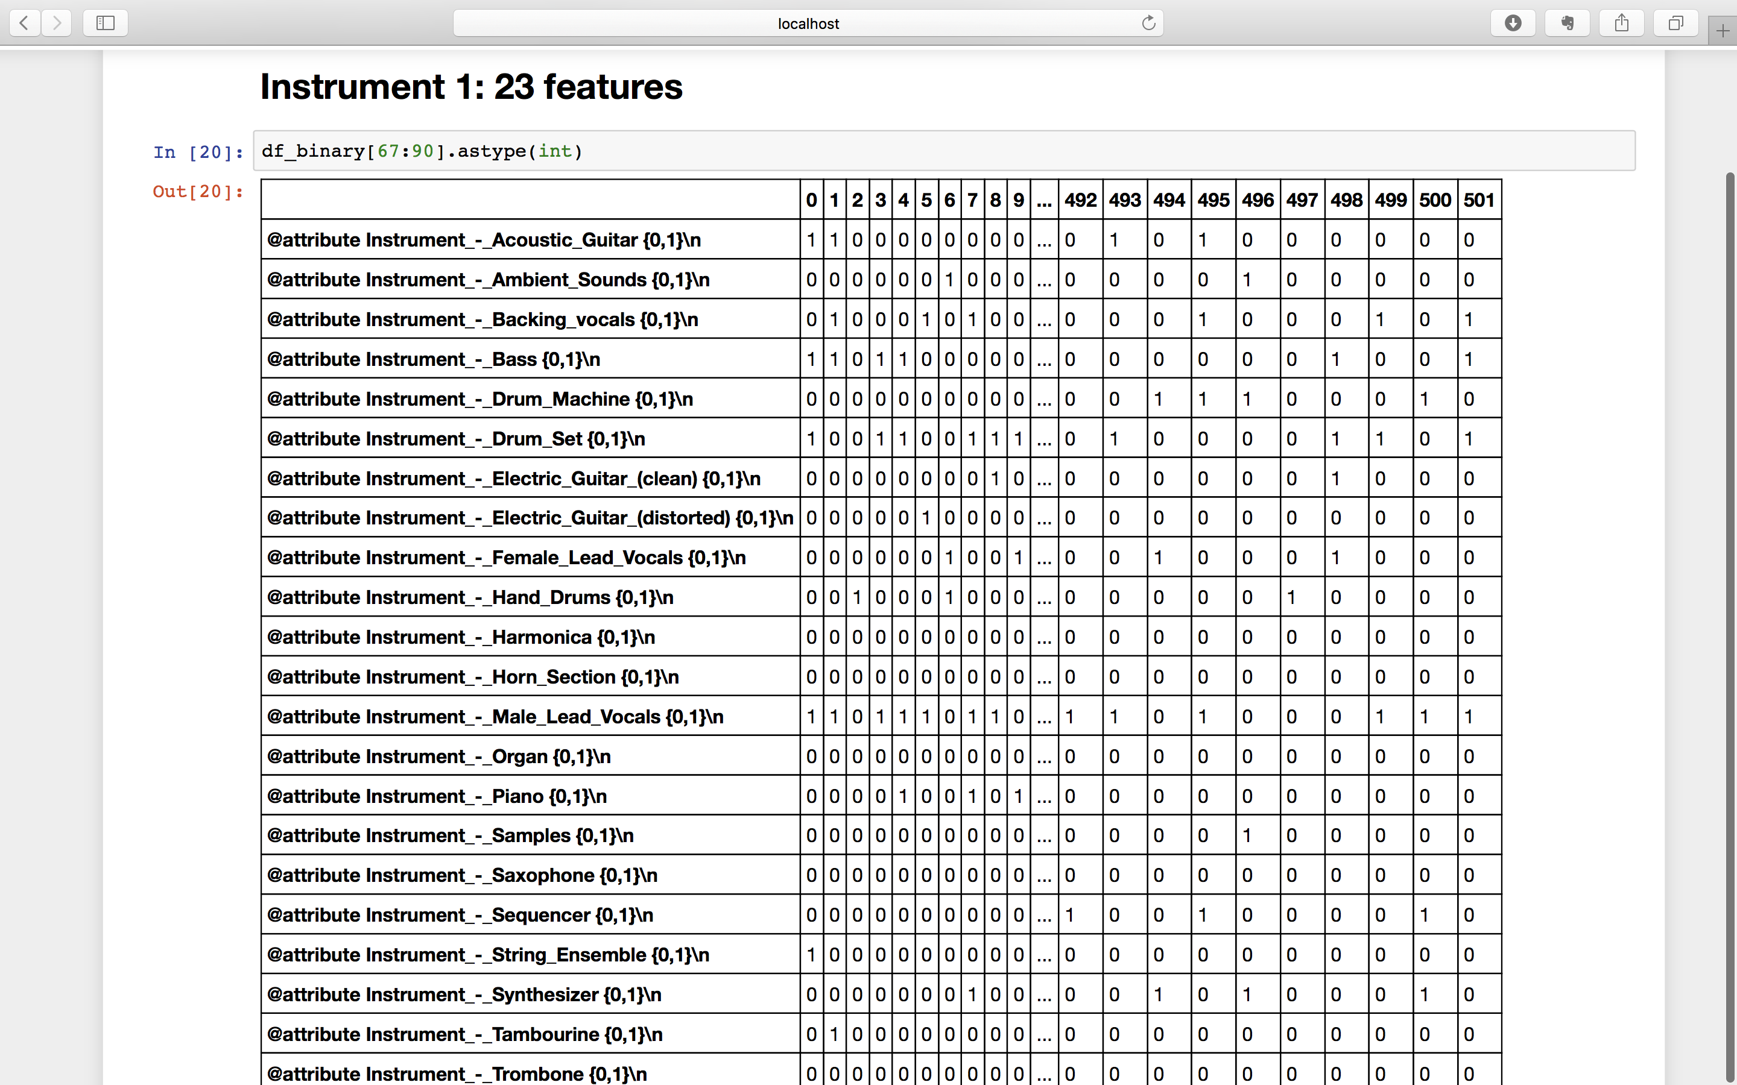

Slide 26
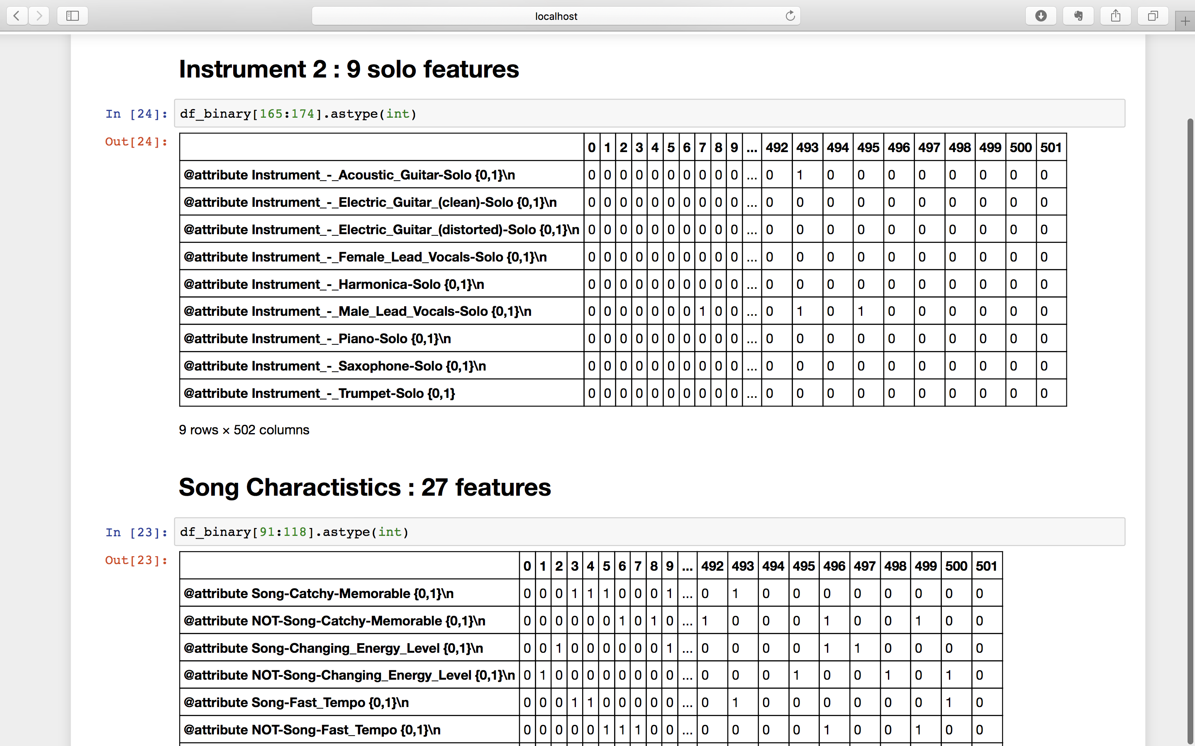

Slide 27
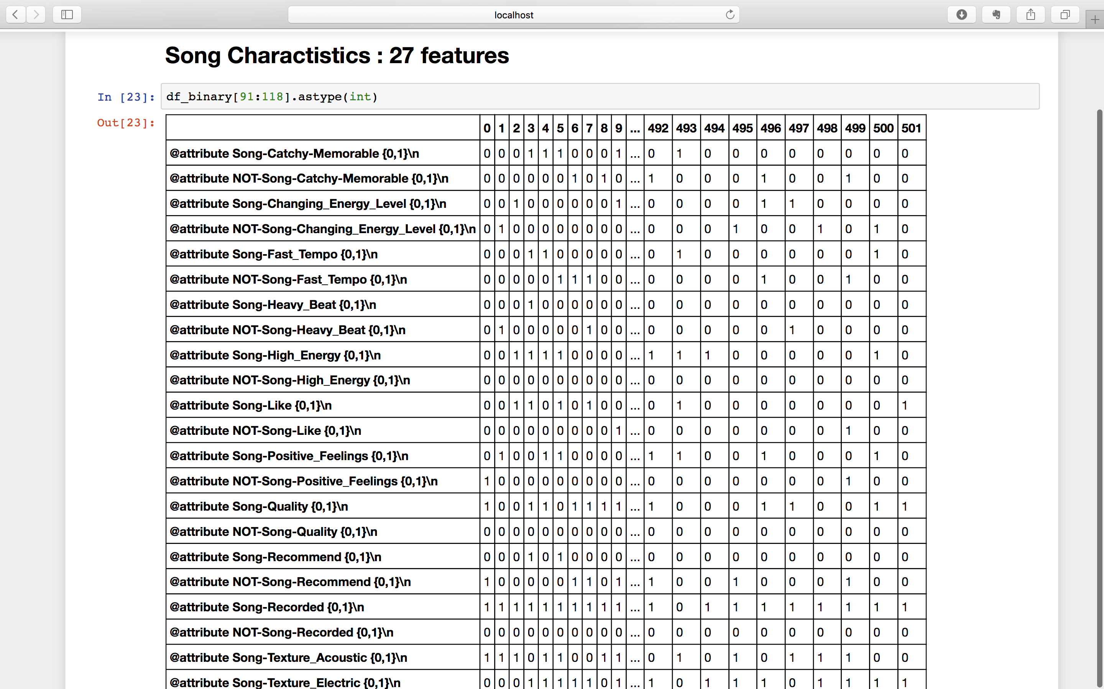

Slide 28
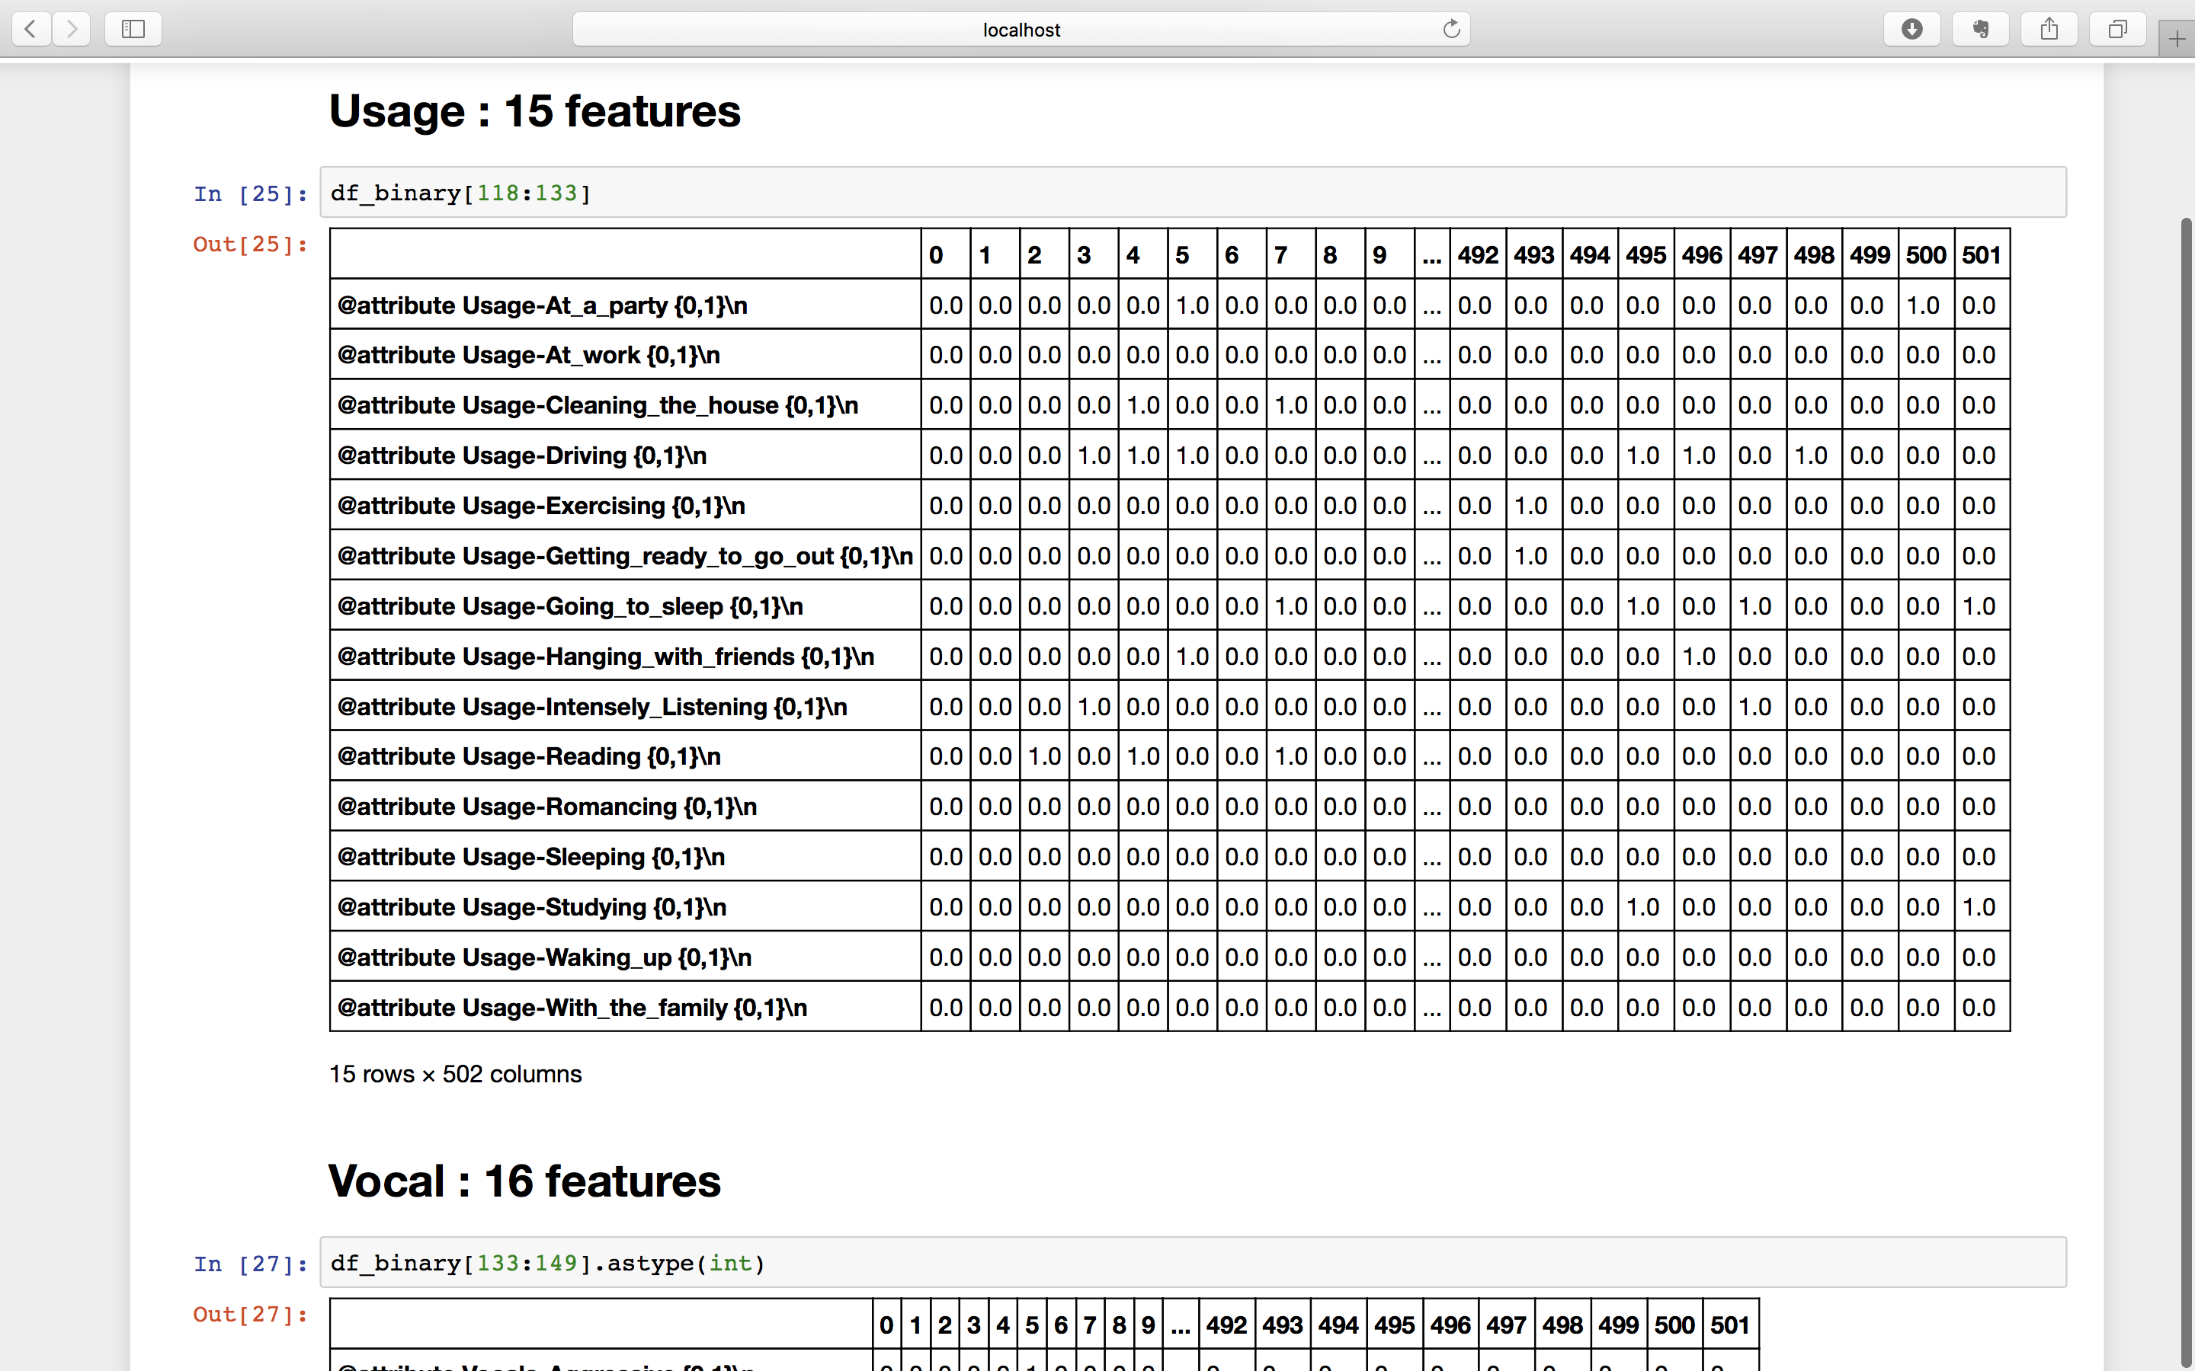

Slide 29
